Slide 1
Microbiome Science
qCMB Introduction
Monday, April 8, 2024

Slide 2
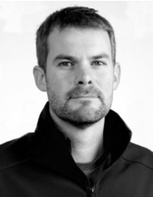

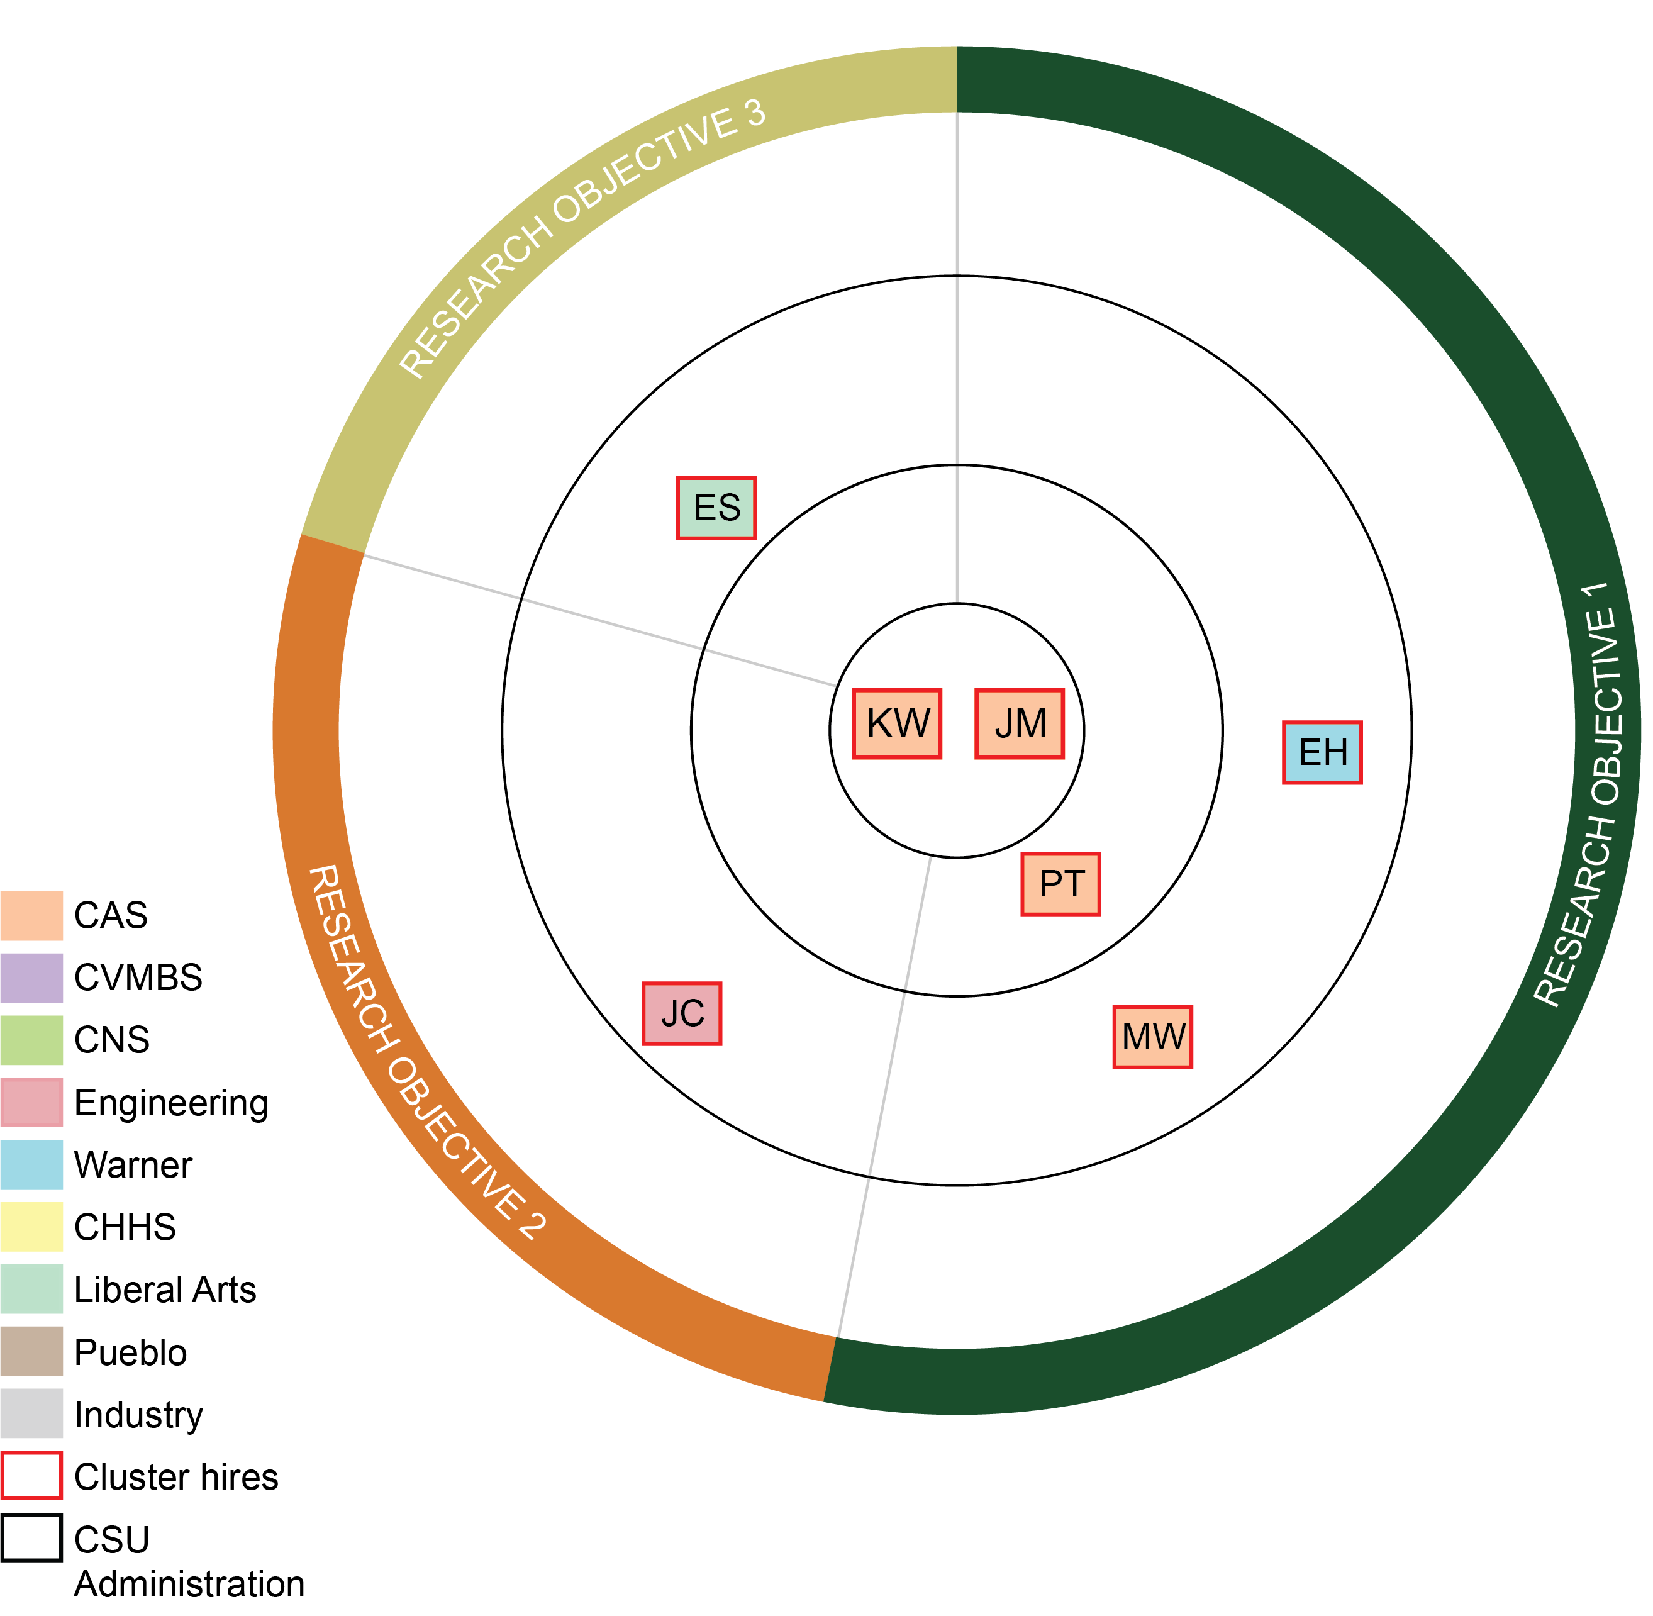
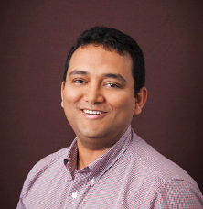

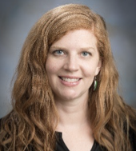

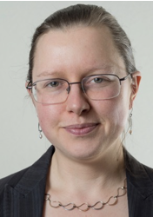
VPR support catalyzed microbiome excellence at CSU
Pankaj Trivedi
CAS
Mike Wilkins
CAS
Kelly Wrighton
CAS
Jessica Metcalf
CAS
Co-Directors of CoSMic
Ed Hall
Warner College
Joshua Chan
Engineering
Erika Syzmanski
Liberal Arts

Slide 3
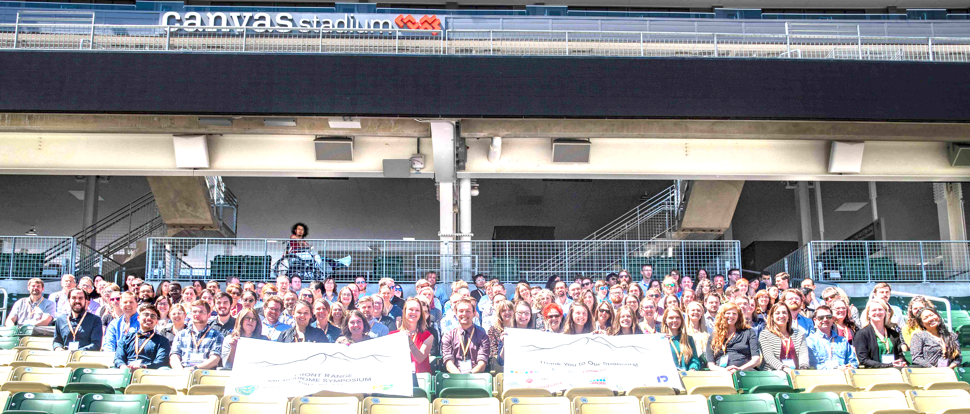
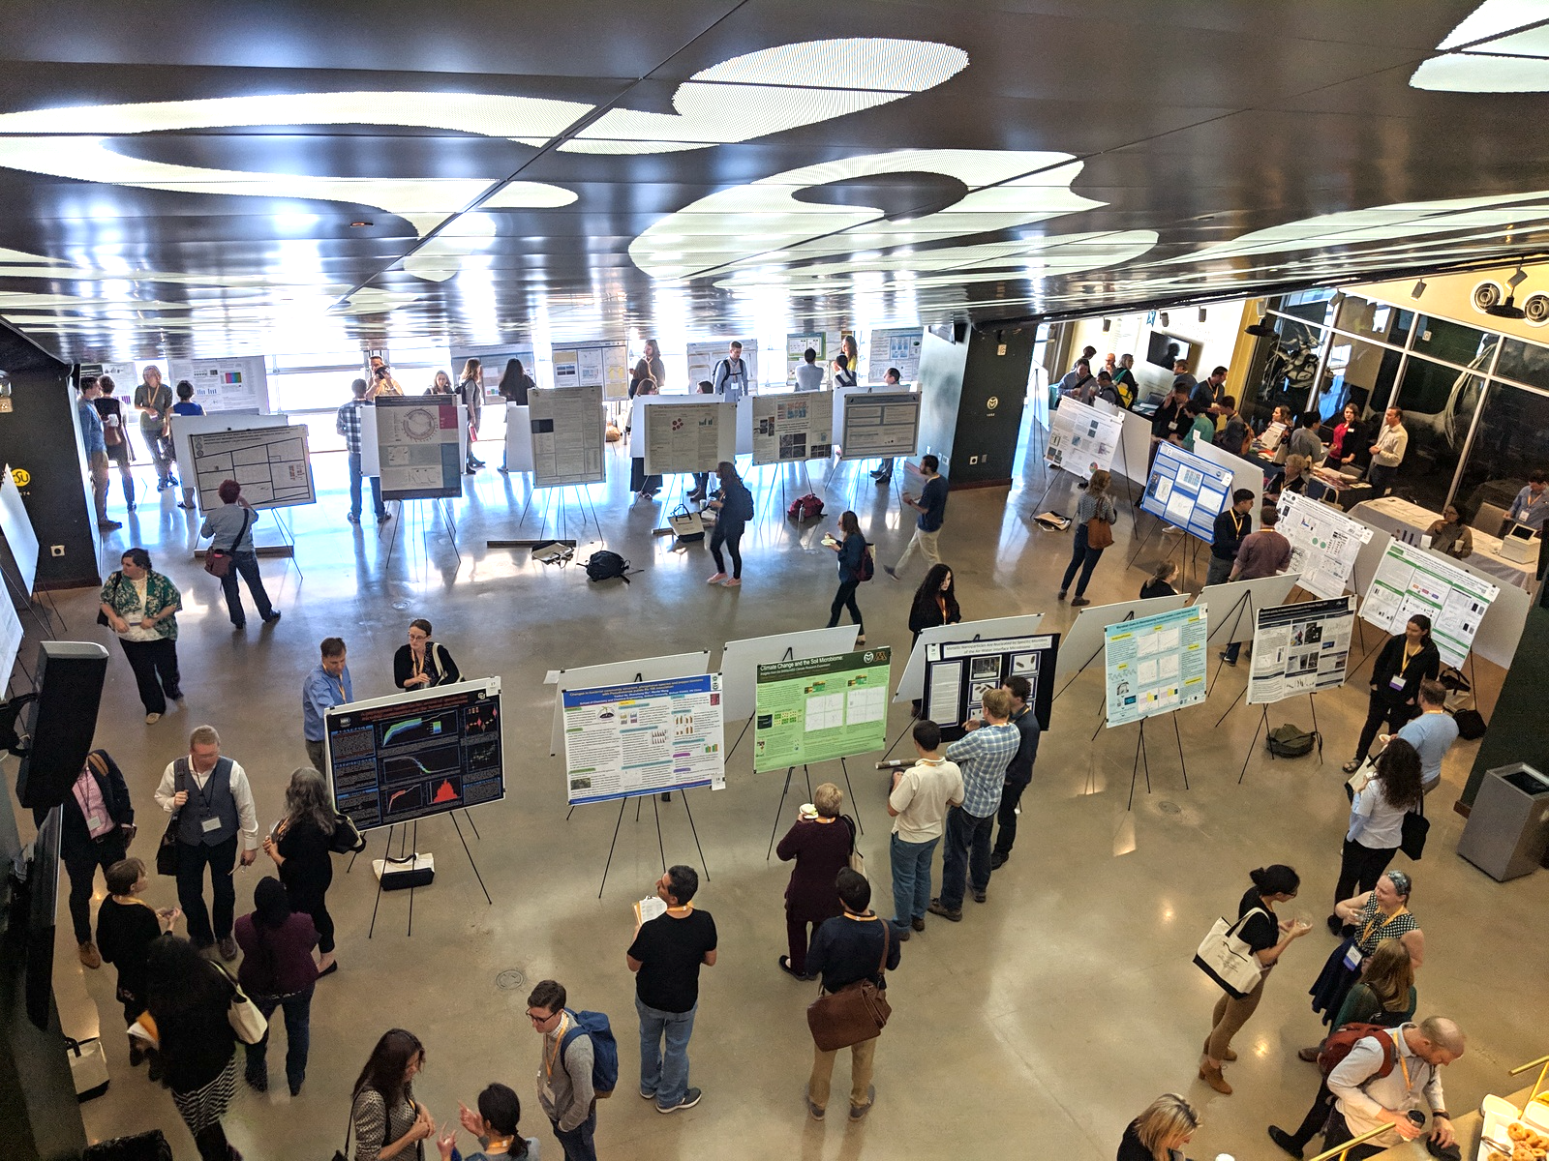








CSU microbiome momentum
Created the Front Range Microbiome symposium
Implemented a graduate degree certificate with an engaged grad community
capitalized on industry and federal investment
3 NSF Biological Integration Institutes!

Slide 4
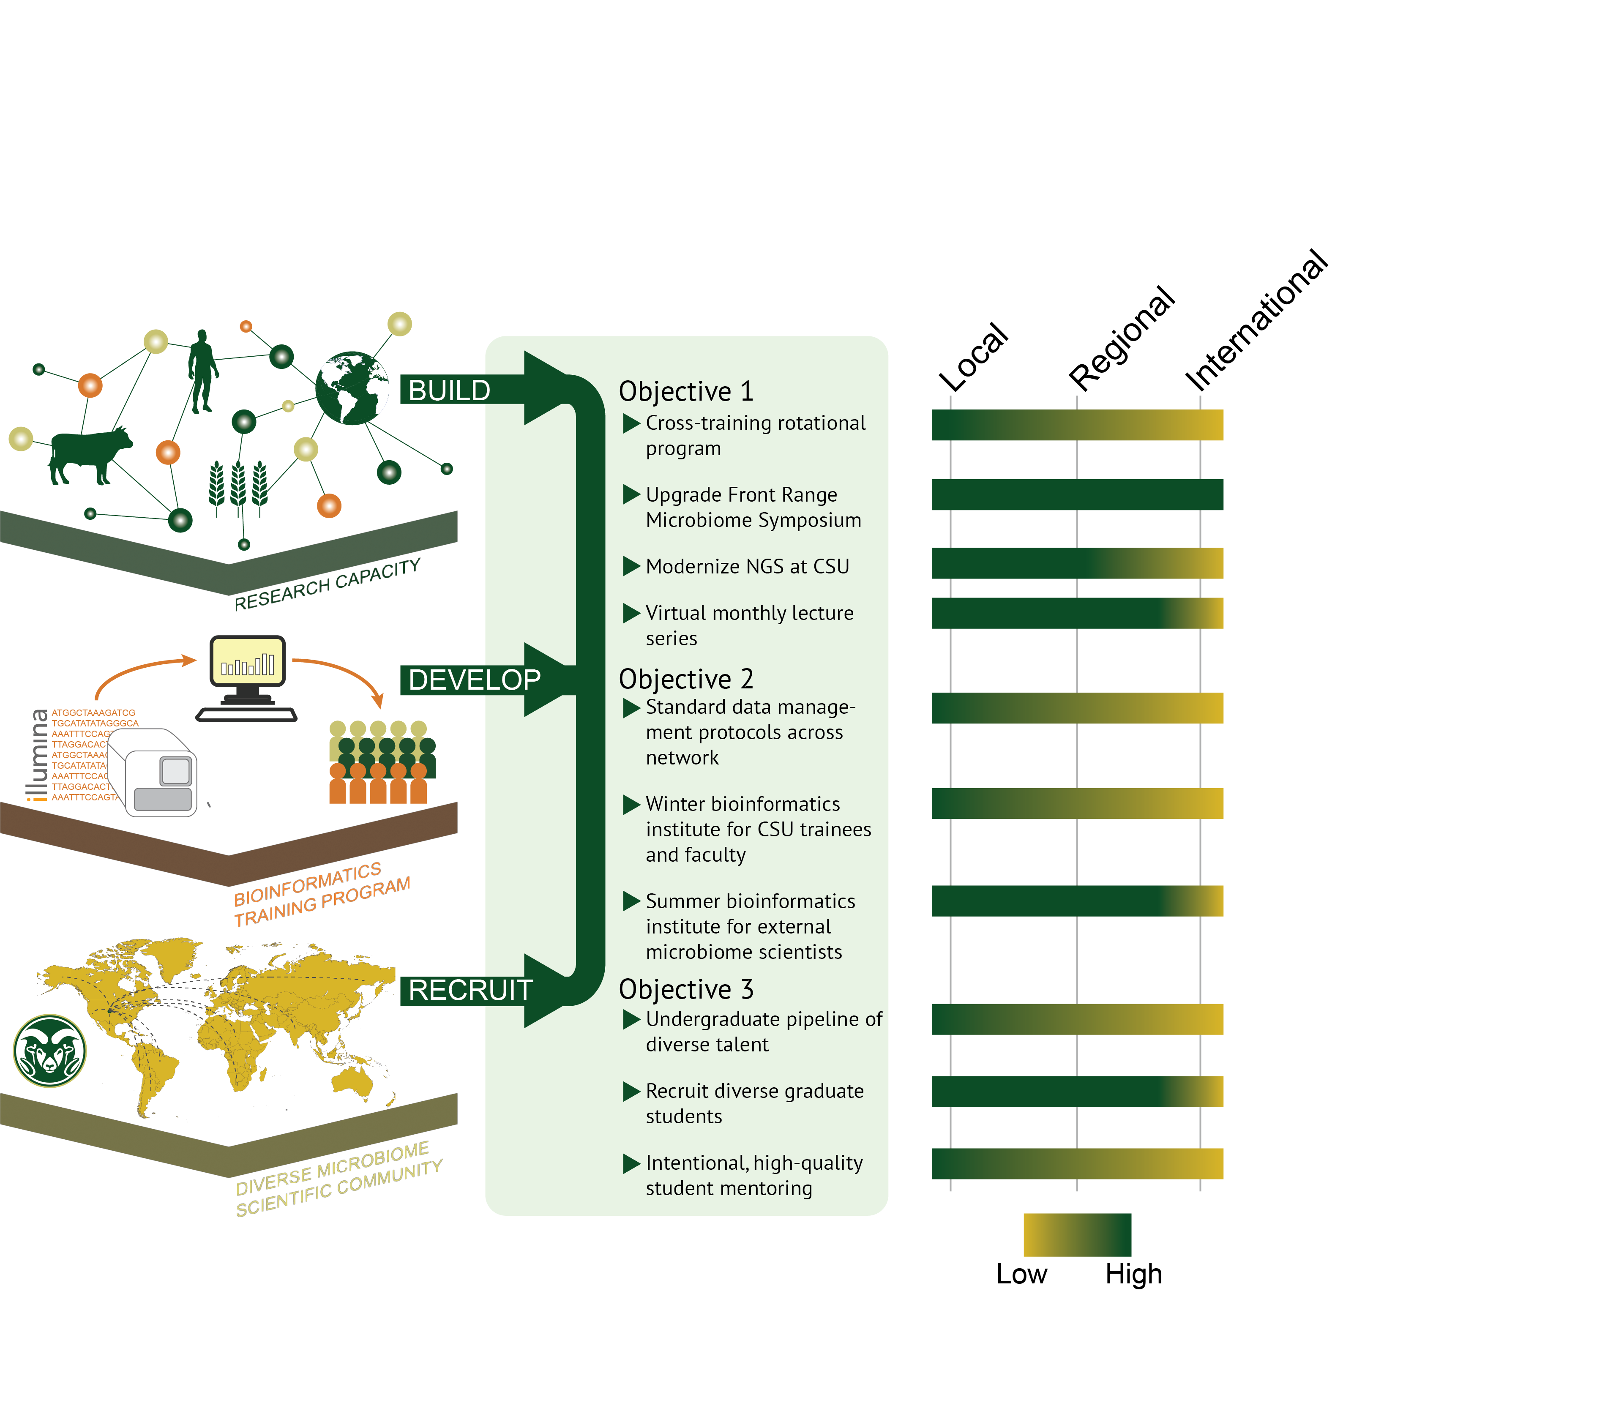
Objective 1
CoSMIC builds research excellence
Scale of influence
Objective 2
CoSMIC develops a bioinformatics reputation
Objective 3
CoSMIC recruits and retains diversity

Slide 5
Microbiome Research
Microbiome – The genes and small molecules of microbes that are interacting in an environment.
Notes:
Microbiome research is a way to study microbial ecology of an environment

Slide 6
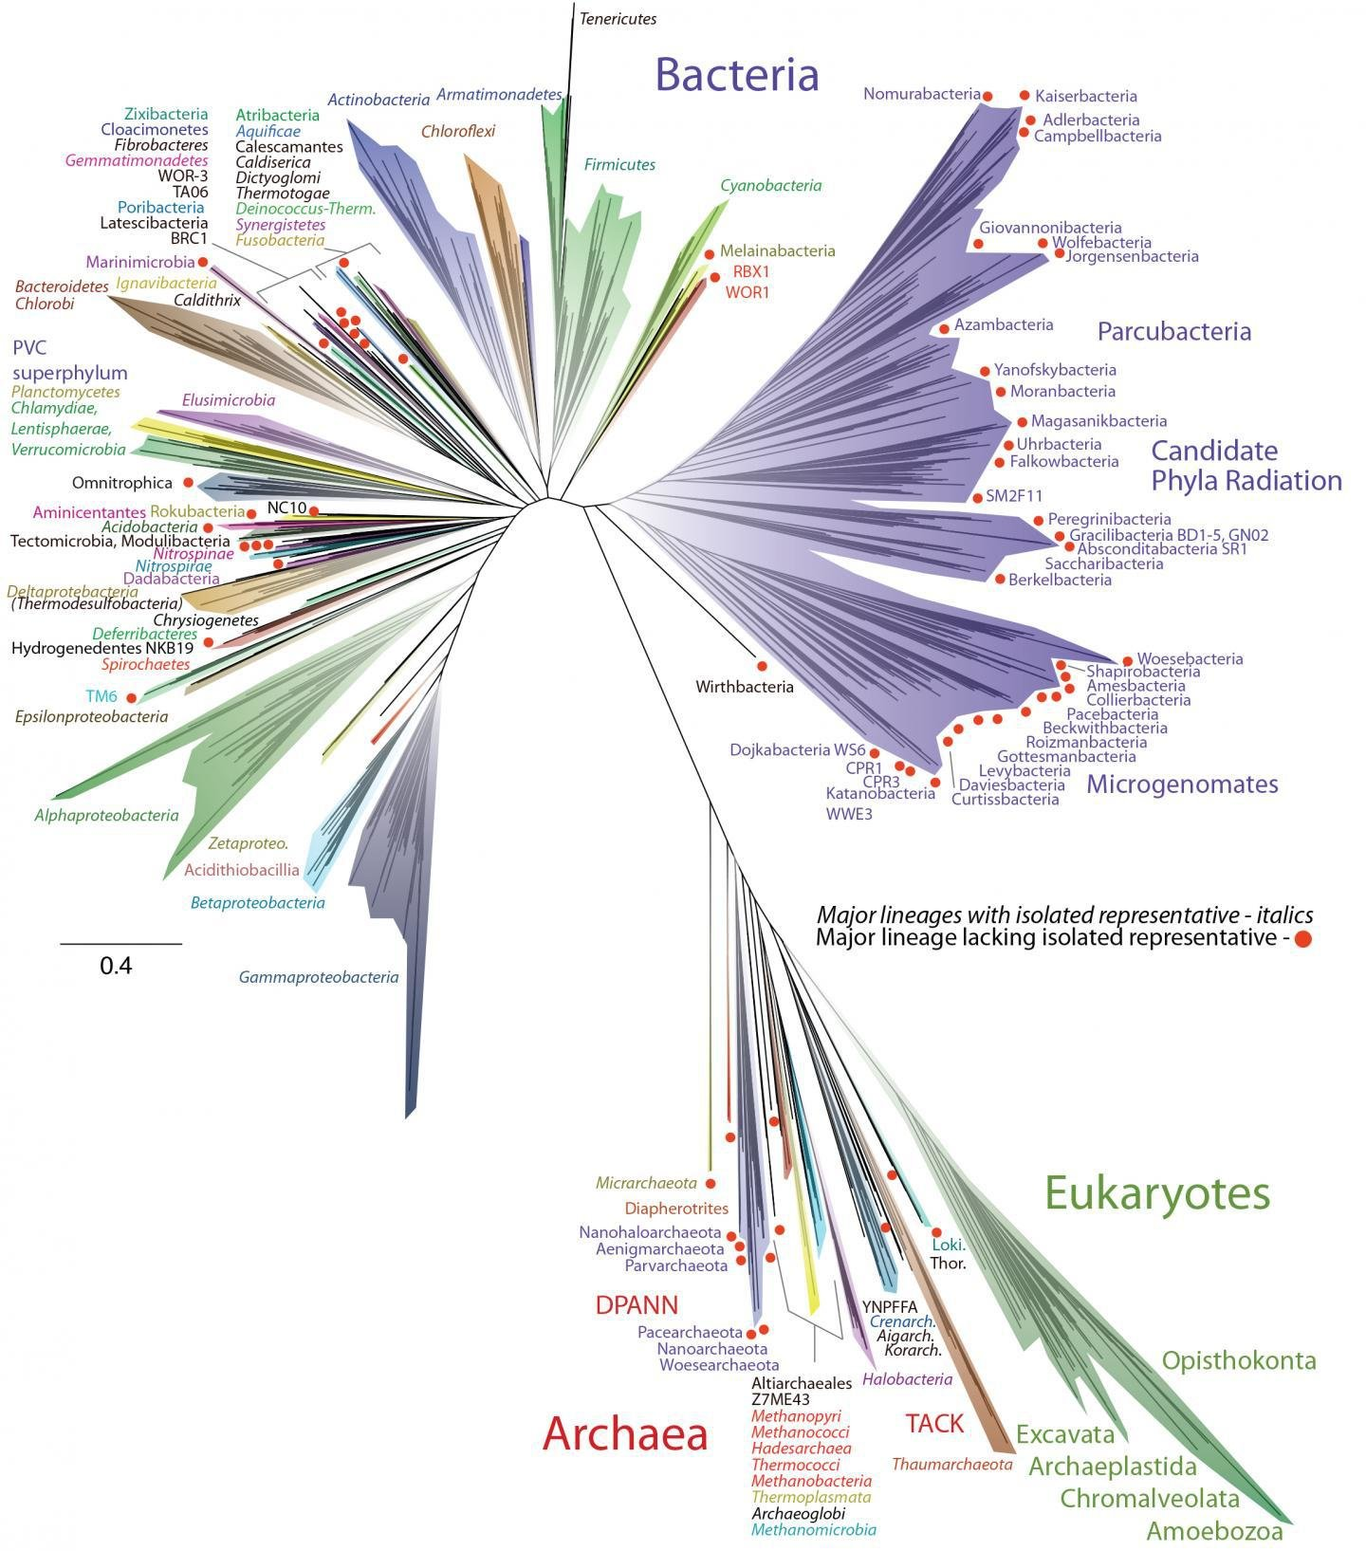
We live in a microbial world
VIRUSES

Slide 7
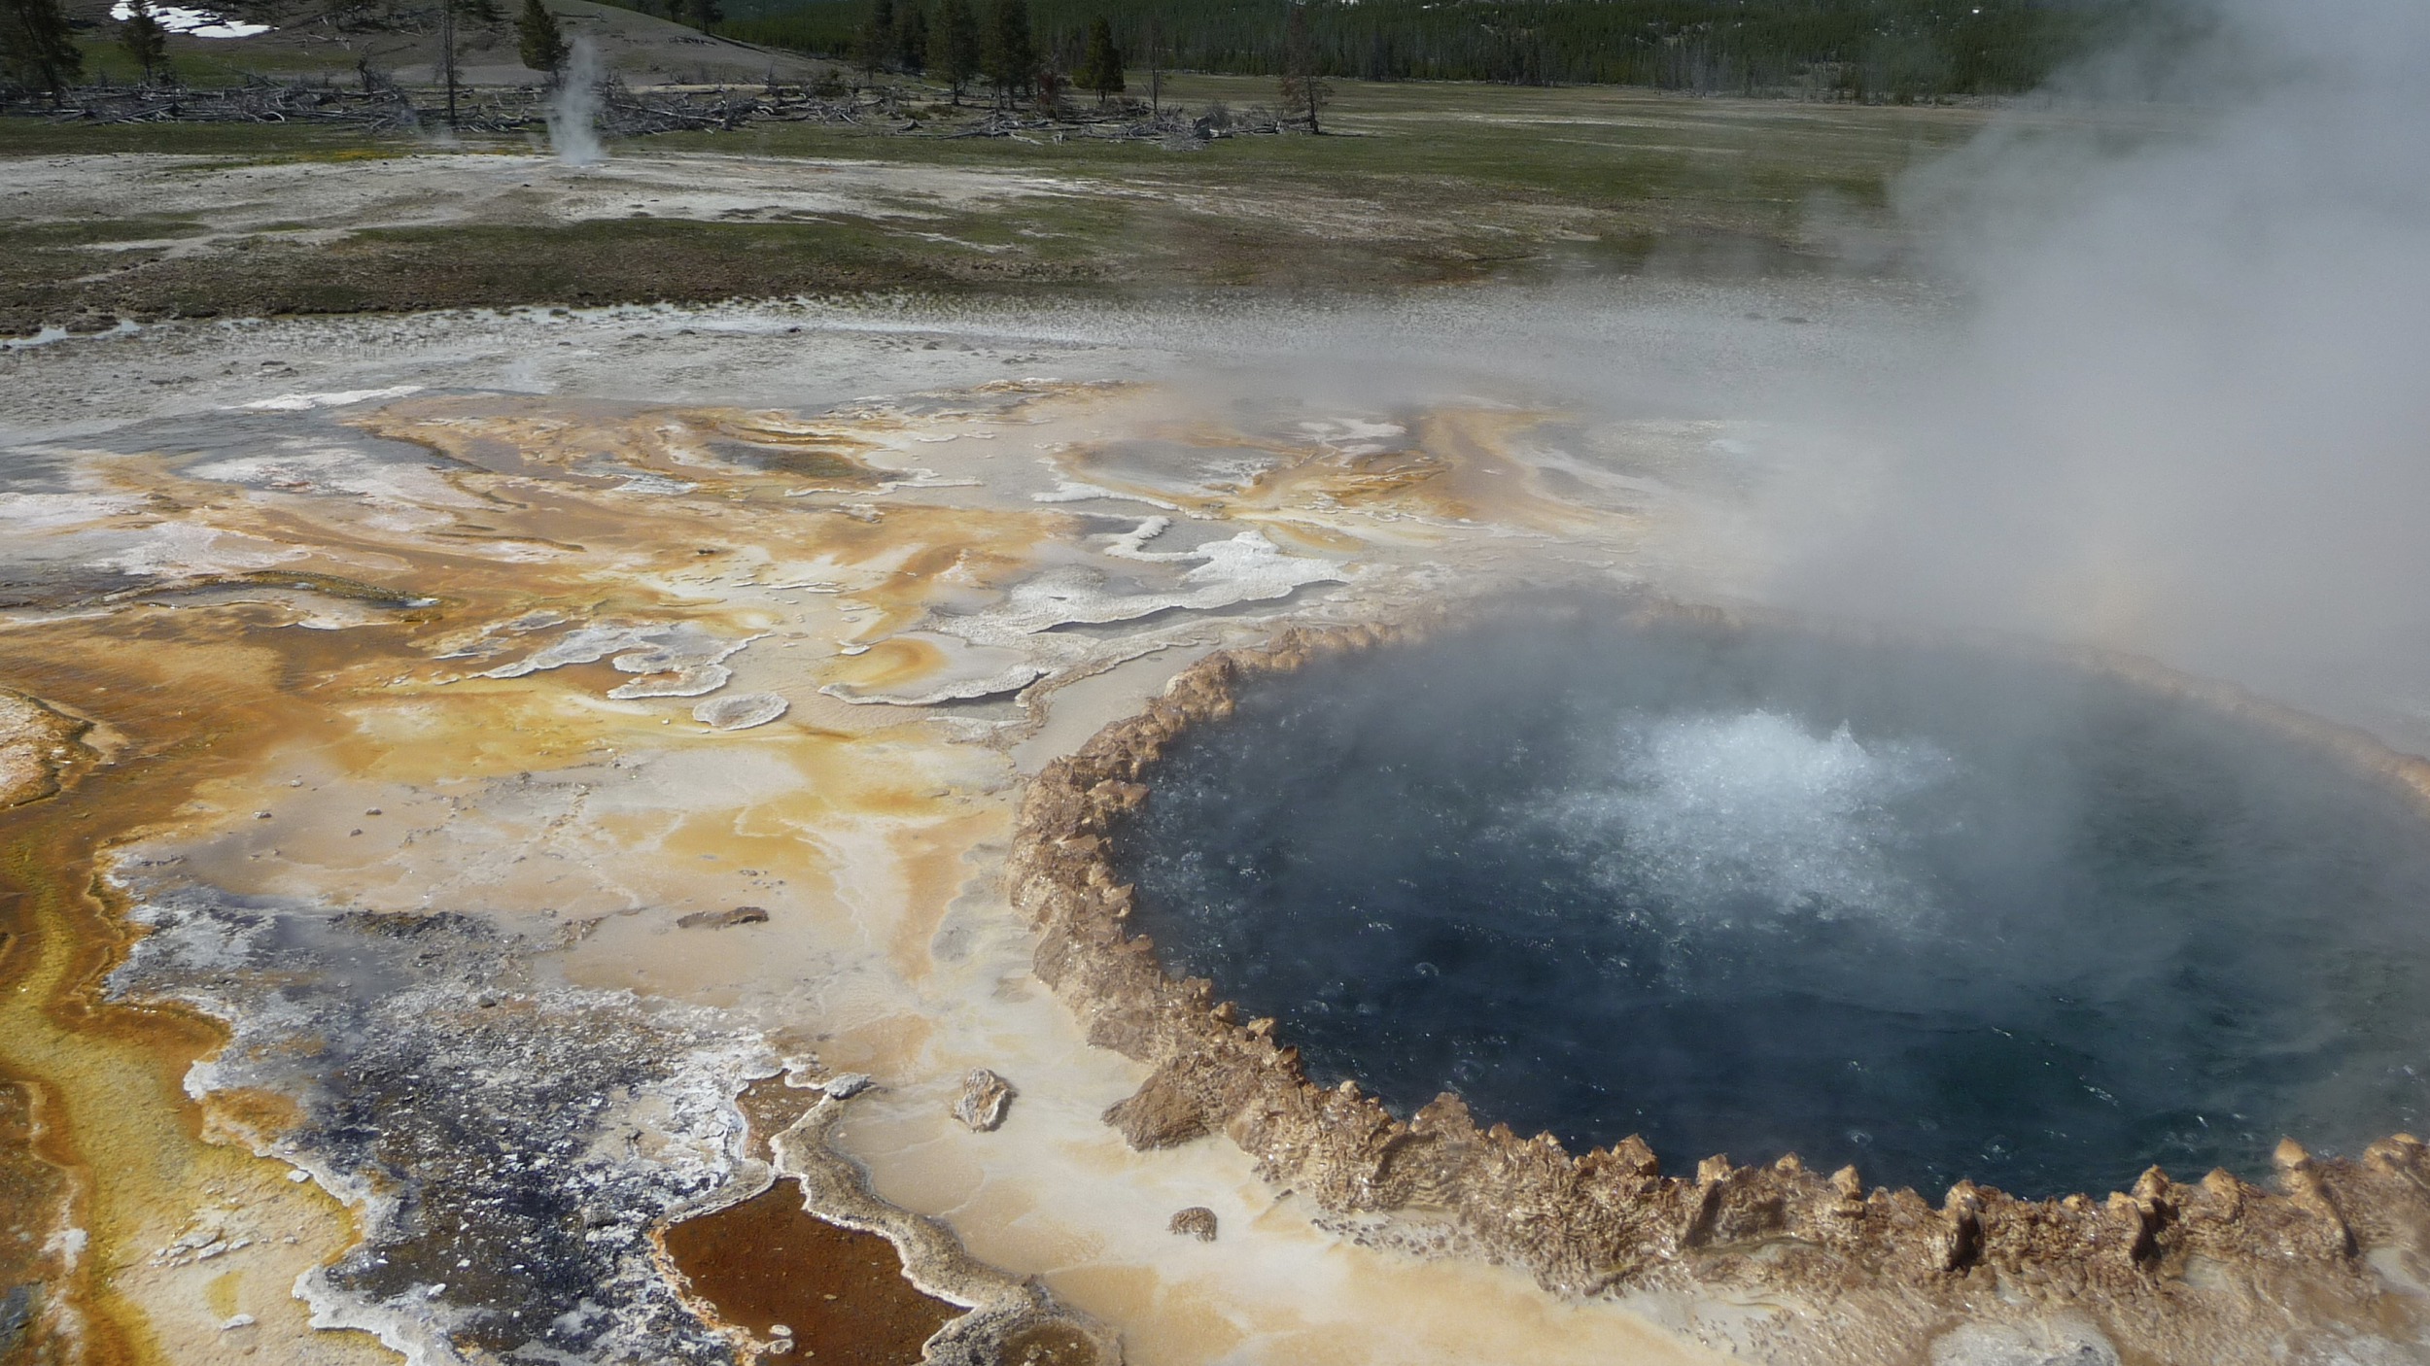
Microbes live in complex and diverse communities, everywhere on Earth
Photo by Greg Caporaso
Notes:
Very hard to find environments that are actually sterile. Yellowstone hotsprings

Slide 8
Microbial ecology is the study of microbes in an environment and their interactions with each other.
Notes:
One example of xx is decomposition. In my lab we study
Microbial ecology is…
Importantly its not the study of one microbe, but a community of microbes and how they are competing or coordinating to perform functions such as decomposition, in my example
http://link.springer.com/referenceworkentry/10.1007%2F978-3-642-30123-0_34#page-1

Slide 9
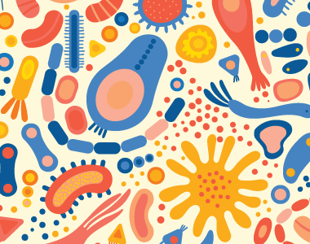
Animals evolved in a sea of microbes
https://worldmicrobiomeday.com/microbial-diversity-quiz/

Slide 10
Partners in Animal Development
Animal development originated and evolved in a microbe-rich environment
Animals have physical barriers or even bacterial symbionts that help protect against pathogens
Some animals (and insects) have bacterial partners transmit from the egg to embryo – some important to postembryonic development
Some insects even require microbial signals for continuation in their life cycles
Notes:
Animal development originated and evolved in a microbe-rich environment – therefore examination into their potential role in development is needed
Early data lead us to anticipate that microbes play a role in providing signals for multiple development stages
Preparing the newborn gut for symbionts
Some insects even require microbial signals for continuation in their life cycles

Slide 11
Protection: Squid-vibrio system
Notes:
Vibrio fischeri is a marine heterotroph that engages in both cooperative and pathogenic interactions with host animals.
The Hawaiian bobtail squid is a small, nocturnal, marine invertebrate that spends its nights hunting for prey in shallow waters.
A sophisticated tool in the bobtail squid's anti-predatory arsenal is a colony of luminous V. fischeri, which are housed in a specialized light organ within the squid's mantle cavity.
The light produced by the symbiont is emitted downward, and the squid can manipulate the intensity of the light to match the intensity of down-welling moon and starlight, thus masking its silhouette to evade bottom-dwelling predators.

Slide 12
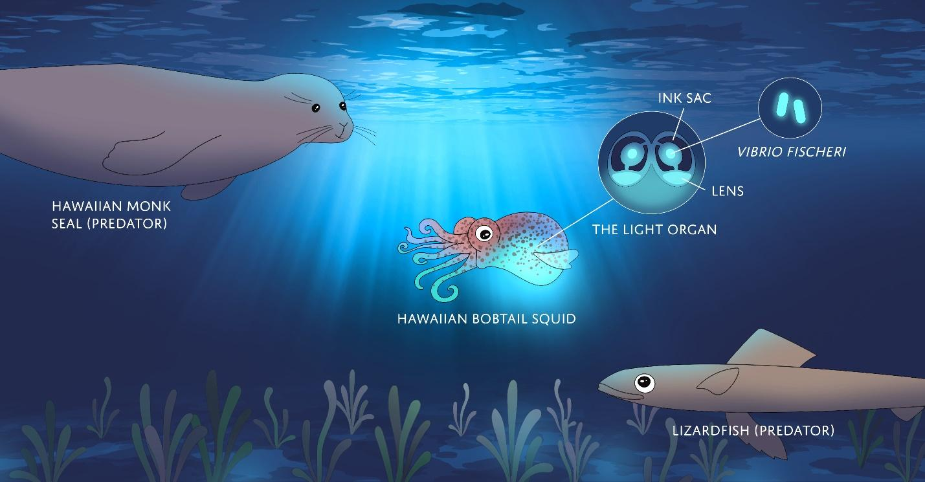

Slide 13
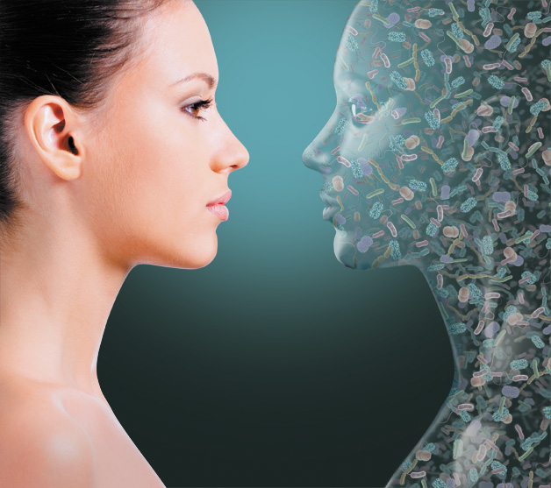
Notes:
The environment can be on an animal. We’ve heard a lot about the human microbiome. It can be any host, including plants.

Slide 14
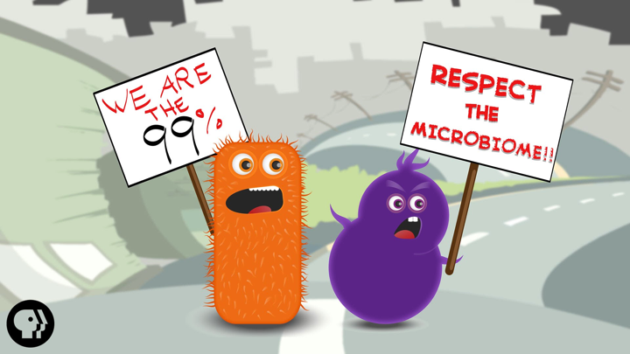
Notes:
99% unique genes bacterial, a lot of metabolism and other opportunities for microbes to influence out health

Slide 15

Benefits of a “healthy microbiome”
Increased nutrient and vitamin uptake
Development and regulation of immune system
Protect against pathogens
Behavior/mood modulation
Notes:
First there is not one “healty microbiome” – depends on all your variables.
Our microbiome confers many benefits to our health and well-being.
These include the ability to ward off pathogens through mechanisms such as overcrowding.
The ability to provide nutrients we cannot generate ourselves.
They produce behavior modification molecules such as serotonin and can help us maintain healthy weights.

Slide 16
Microbiome
Microbiology
Ecology
Genomics
Chemistry

Slide 17
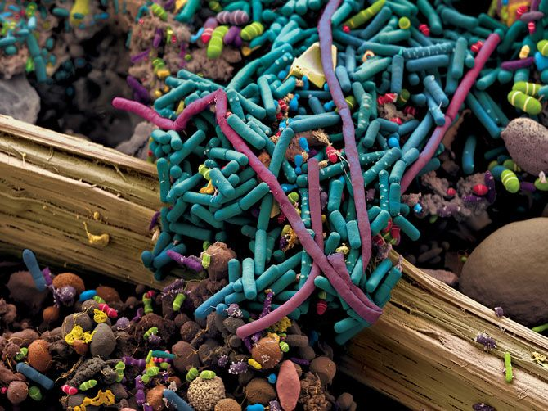
We study …
structure,
diversity,
function,
communication
Microbial
Communities
We sample ....
DNA,
RNA,
proteins,
metabolites
Microbial
Community
Notes:
In this class DNA, community structure and diversity

Slide 18
Metagenomics is the study of a collection of genetic material (genomes) from a mixed community of organisms.
Also sometimes referred to as “shotgun metagenomics”
https://www.genome.gov/

Slide 19
What if you want to study a particular community like bacteria, fungi, or even macro plants, insects, etc?

Slide 20
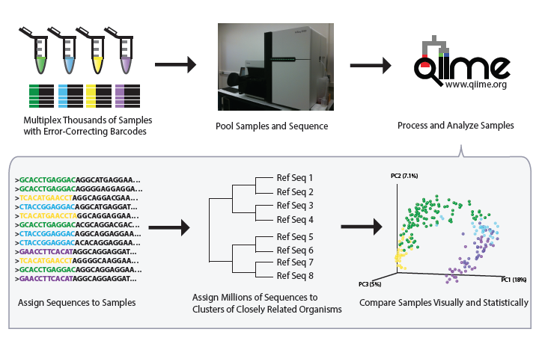
Amplicon sequencing
Notes:
Target a universal gene: 16S, 18S, ITS, TrNL, COI
Many people don’t really consider this metagenomics, b.c not really genome studies
What we will work on the next two days

Slide 21
What characteristics of a gene make it a good marker?
Genes that are ubiquitous (e.g. important to the function of all living organisms)
Genes that contains both:
Conserved region – common between all microbes of interest e.g. a gene region present in all bacteria and archaea (so universal primers can find it)
Variable region – different between taxa contained within your microbial group of interest e.g. a region within a bacterial marker gene that differentiates E. coli or P. aeruginosa

Slide 22
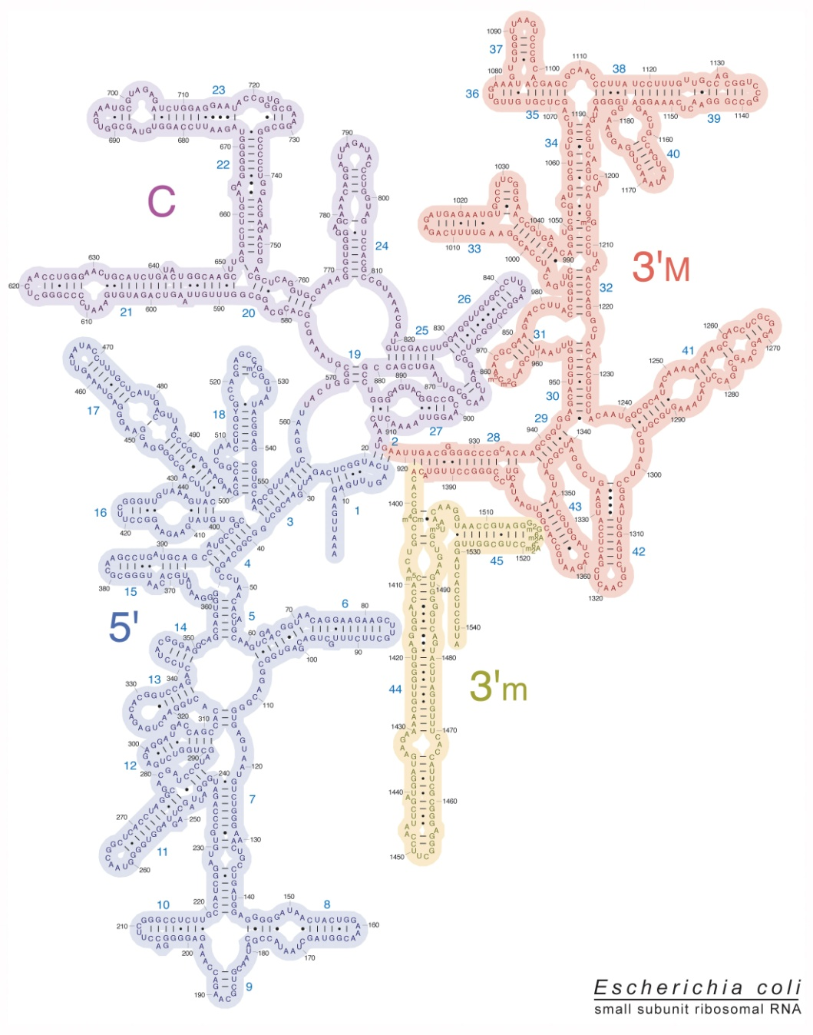
16S ribosomal RNA
16S rRNA – part of the small subunit in prokaryotic ribosomes
Has multiple functions:
Binds to the Shine-Dalgarno sequence, a ribosomal binding site in bacterial and archaeal mRNA that is involved in recruiting the ribosome to initiate translation
Acts as a scaffold for ribosomal proteins
Helps to stabilize correct protein synthesis
Notes:
Part of the 30S or small ribosomal subunit in prokaryotes, supports binding and reading of mRNA during translation

Slide 23
16S rRNA amplicon sequencing
Notes:
There are 9 hypervariable regions bookended by conserved regions

Slide 24
Sequencing primer
Barcode
Primer pad
Linker
515f
AATGATACGGCGACCACCGAGATCTACACGCT XXXXXXXXXXXX TATGGTAATT GT GTGYCAGCMGCCGCGGTAA
Plate Name(s) | Plate Number | Well Position |  | Sequence | Barcode
IL_515fBC_Jed_Arch_1 | Plate 1 | A1 |  | AATGATACGGCGACCACCGAGATCTACACGCTAGCCTTCGTCGCTATGGTAATTGTGTGYCAGCMGCCGCGGTAA | AGCCTTCGTCGC
IL_515fBC_Jed_Arch_1 | Plate 1 | A2 |  | AATGATACGGCGACCACCGAGATCTACACGCTTCCATACCGGAATATGGTAATTGTGTGYCAGCMGCCGCGGTAA | TCCATACCGGAA
IL_515fBC_Jed_Arch_1 | Plate 1 | A3 |  | AATGATACGGCGACCACCGAGATCTACACGCTAGCCCTGCTACATATGGTAATTGTGTGYCAGCMGCCGCGGTAA | AGCCCTGCTACA
IL_515fBC_Jed_Arch_1 | Plate 1 | A4 |  | AATGATACGGCGACCACCGAGATCTACACGCTCCTAACGGTCCATATGGTAATTGTGTGYCAGCMGCCGCGGTAA | CCTAACGGTCCA
IL_515fBC_Jed_Arch_1 | Plate 1 | A5 |  | AATGATACGGCGACCACCGAGATCTACACGCTCGCGCCTTAAACTATGGTAATTGTGTGYCAGCMGCCGCGGTAA | CGCGCCTTAAAC
IL_515fBC_Jed_Arch_1 | Plate 1 | A6 |  | AATGATACGGCGACCACCGAGATCTACACGCTTATGGTACCCAGTATGGTAATTGTGTGYCAGCMGCCGCGGTAA | TATGGTACCCAG
IL_515fBC_Jed_Arch_1 | Plate 1 | A7 |  | AATGATACGGCGACCACCGAGATCTACACGCTTACAATATCTGTTATGGTAATTGTGTGYCAGCMGCCGCGGTAA | TACAATATCTGT
IL_515fBC_Jed_Arch_1 | Plate 1 | A8 |  | AATGATACGGCGACCACCGAGATCTACACGCTAATTTAGGTAGGTATGGTAATTGTGTGYCAGCMGCCGCGGTAA | AATTTAGGTAGG
IL_515fBC_Jed_Arch_1 | Plate 1 | A9 |  | AATGATACGGCGACCACCGAGATCTACACGCTGACTCAACCAGTTATGGTAATTGTGTGYCAGCMGCCGCGGTAA | GACTCAACCAGT
IL_515fBC_Jed_Arch_1 | Plate 1 | A10 |  | AATGATACGGCGACCACCGAGATCTACACGCTGCCTCTACGTCGTATGGTAATTGTGTGYCAGCMGCCGCGGTAA | GCCTCTACGTCG
Notes:
There are many ways to build an amplicon library or amplicon pool for sequencing. One way or the other, you want to be able to mix amplicons from hundreds of samples to be sequenced in a single run

Slide 25
Sequencing primer
Barcode
Primer pad
Linker
515f
AATGATACGGCGACCACCGAGATCTACACGCT XXXXXXXXXXXX TATGGTAATT GT GTGYCAGCMGCCGCGGTAA
Plate Name(s) | Plate Number | Well Position |  | Sequence | Barcode
IL_515fBC_Jed_Arch_1 | Plate 1 | A1 |  | AATGATACGGCGACCACCGAGATCTACACGCTAGCCTTCGTCGCTATGGTAATTGTGTGYCAGCMGCCGCGGTAA | AGCCTTCGTCGC
IL_515fBC_Jed_Arch_1 | Plate 1 | A2 |  | AATGATACGGCGACCACCGAGATCTACACGCTTCCATACCGGAATATGGTAATTGTGTGYCAGCMGCCGCGGTAA | TCCATACCGGAA
IL_515fBC_Jed_Arch_1 | Plate 1 | A3 |  | AATGATACGGCGACCACCGAGATCTACACGCTAGCCCTGCTACATATGGTAATTGTGTGYCAGCMGCCGCGGTAA | AGCCCTGCTACA
IL_515fBC_Jed_Arch_1 | Plate 1 | A4 |  | AATGATACGGCGACCACCGAGATCTACACGCTCCTAACGGTCCATATGGTAATTGTGTGYCAGCMGCCGCGGTAA | CCTAACGGTCCA
IL_515fBC_Jed_Arch_1 | Plate 1 | A5 |  | AATGATACGGCGACCACCGAGATCTACACGCTCGCGCCTTAAACTATGGTAATTGTGTGYCAGCMGCCGCGGTAA | CGCGCCTTAAAC
IL_515fBC_Jed_Arch_1 | Plate 1 | A6 |  | AATGATACGGCGACCACCGAGATCTACACGCTTATGGTACCCAGTATGGTAATTGTGTGYCAGCMGCCGCGGTAA | TATGGTACCCAG
IL_515fBC_Jed_Arch_1 | Plate 1 | A7 |  | AATGATACGGCGACCACCGAGATCTACACGCTTACAATATCTGTTATGGTAATTGTGTGYCAGCMGCCGCGGTAA | TACAATATCTGT
IL_515fBC_Jed_Arch_1 | Plate 1 | A8 |  | AATGATACGGCGACCACCGAGATCTACACGCTAATTTAGGTAGGTATGGTAATTGTGTGYCAGCMGCCGCGGTAA | AATTTAGGTAGG
IL_515fBC_Jed_Arch_1 | Plate 1 | A9 |  | AATGATACGGCGACCACCGAGATCTACACGCTGACTCAACCAGTTATGGTAATTGTGTGYCAGCMGCCGCGGTAA | GACTCAACCAGT
IL_515fBC_Jed_Arch_1 | Plate 1 | A10 |  | AATGATACGGCGACCACCGAGATCTACACGCTGCCTCTACGTCGTATGGTAATTGTGTGYCAGCMGCCGCGGTAA | GCCTCTACGTCG
96-well plate

Slide 26
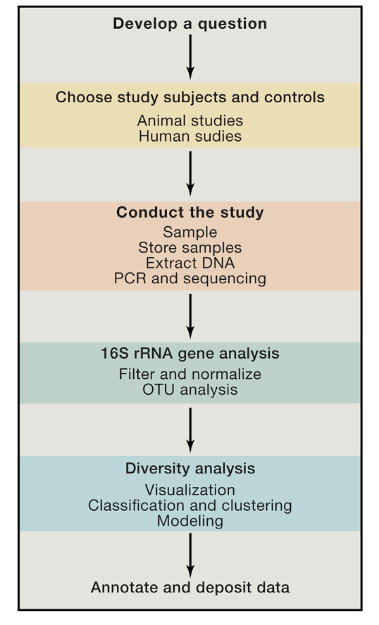
Performing a microbiome study
Study design
(power, randomization)
(metadata--standard + specific to your study)
Sample Information
Sample collection
(method, shipping/storage)
lab protocols
(include neg/pos controls)
Sequence Data
Data processing
Feature Table
Data analysis
Summary Statistics
For more on these topics, see:
Conducting a Microbiome Study, by Goodrich et al. 2014
Reagent Contamination, Salter et al. 2014
Storage effects, by Song et al. 2016
Microbiome Quality Control (MBQC), by Sinha et al. 2017
MIMARKS, by Yilmaz et al. 2011
KatharoSeq low biomass workflow, by Minich et al. 2017
Other resources:
Earth Microbiome Project website
Human Microbiome Project website
American Gut Project website
Notes:
These are the basic steps to performing a microbiome study - steps on left are the overarching steps
Stuff in the middle is a little more detailed, relevant to the types of studies we focus on in this workshop
We will focus on data analysis in this 2 day module. I will walk us through some of the process steps that you won’t do so you can get an idea

Slide 27
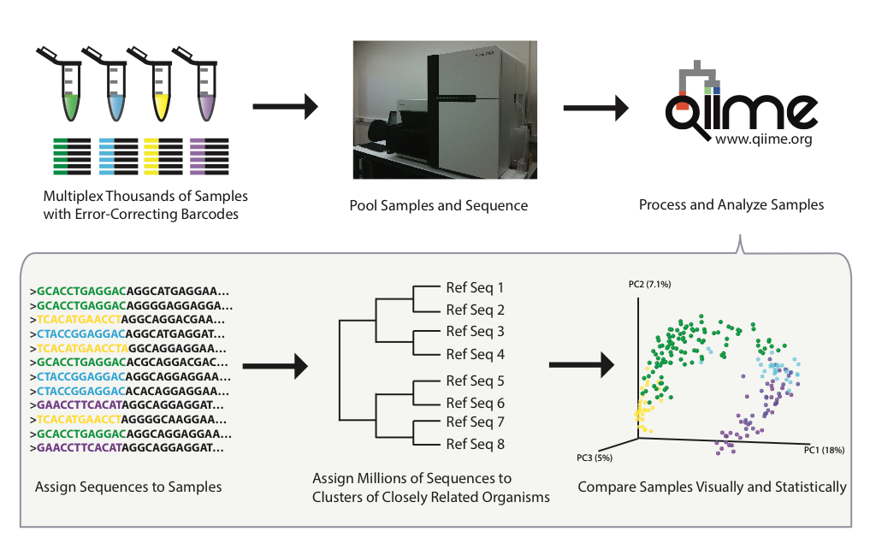
Demultiplexing
Bioinformatically undoing the multiplexing
L1S8
L1S57
L1S76
L1S105
Notes:
Pool samples together in equimolar concentrations and run in a single MiSeq lane – the amount of samples you put on a plate will relate to the resulting sequencing depth. So you may potentially want less samples on a plate if you expect high diversity samples.

Slide 28
Demultiplexing
Bioinformatically undoing the multiplexing
L1S8
L1S57
L1S76
L1S105
L1S8
L1S57
L1S76
L1S105

Slide 29
Import data
Demultiplexed fasta file
sequences.fastq(.gz)
SampleData[SequencesWithQuality]
@HWI-6X_9267:1:1:25:1051
GACGAAGGTGACGACCGTTGCTCGGAATCACTGGGCATAAAGCGCGCGTAGGTGGCTTGGTAAGTCCATGGTGAAATCCCTCGGCTCAACCGAGGAACTG
+
abaaaaa`^`a_]^\``\``a`^`]]]^^`a[VXGX``Z_\\\_^\a^SYOZVVSVYGYVDXOZVT\TITBBBBBBBBBBBBBBBBBBBBBBBBBBBBBB
@HWI-6X_9267:1:1:25:267
TACGTATGGGGCAAGCGTTATCCGGAATTATTGGGCGTAAAGAGTGCGTAGGTGGTGGCTTAAGCGCAGGGTTTAAGGCAATGGCTTAACTATTGTTCTC
+
aa^^[__^^^_^_^[^^[^^____ZZ[^^[^]ZUZ]]WUZXYU[Q[X]UVXVN[XUWWURZUYY]XXRZRNVTRTNTWUUU^VJVOMIHQU\URRN[BBB
@HWI-6X_9267:1:1:25:609
TACGTAGGGGGCAAGCGTTATCCGGATTTACTGGGTGTAAAGGGAGCGTAGACGGATGGACAAGTCTGATGTGAAAGGCTGGGGCTCAACCCCGGGACGG
+
aaab`aaa`aaaaaaaaaaaaaaaa^aaaaaaaaYQ^`_^]a_]\a`a]``]Z_[][I^^aZZ^WW^_^`ZZ_T]XY^^\^ZX\ZJS[W[V^\HOVYTET
@HWI-6X_9267:1:1:25:519
GACGGAGGATGCAAGTGTTATCCGGAATCACTGGGCGTAAAGCGTCTGTAGGTGGTTTACTAAGTCAACTGTTAAATCTTGAGGCTCAACCTCGAAATCG
+
abaaaaaa`aaaaaa\aaaaaaa```aa_aaaa^Z__[ZY^aa`U[`^[]]YZ]WY]]_Z_XX\\[]]]^`[\XTVX]`T_VZ[]ZXVXYFX_VYJWWZL
@HWI-6X_9267:1:1:25:1109
TACGGAGGGTGCGAGCGTTAATCGGAATTACTGGGCGTAAAGCGTACGTAGGCGGTTAGGTAAGTCAGATGTGAAAGCCCCGGGCTCCACCTGGGAATGG
+
aaaba^`a^N_`\_``a_a]Zaa^^\Z`[M]a`[VYa^_X^_Z]NZ\`]TY\]_^RVH_PHOWZM[PTRPTRYUBBBBBBBBBBBBBBBBBBBBBBBBBB
4ac2.fastq(.gz)
@HWI-6X_9267:1:1:25:1051
GACGAAGGTGACGACCGTTGCTCGGAATCACTGGGCATAAAGCGCGCGTAGGTGGCTTGGTAAGTCCATGGTGAAATCCCTCGGCTCAACCGAGGAACTG
+
abaaaaa`^`a_]^\``\``a`^`]]]^^`a[VXGX``Z_\\\_^\a^SYOZVVSVYGYVDXOZVT\TITBBBBBBBBBBBBBBBBBBBBBBBBBBBBBB
@HWI-6X_9267:1:1:25:609
TACGTAGGGGGCAAGCGTTATCCGGATTTACTGGGTGTAAAGGGAGCGTAGACGGATGGACAAGTCTGATGTGAAAGGCTGGGGCTCAACCCCGGGACGG
+
aaab`aaa`aaaaaaaaaaaaaaaa^aaaaaaaaYQ^`_^]a_]\a`a]``]Z_[][I^^aZZ^WW^_^`ZZ_T]XY^^\^ZX\ZJS[W[V^\HOVYTET
barcodes.fastq(.gz)
e375.fastq(.gz)
@HWI-6X_9267:1:1:25:267
TACGTATGGGGCAAGCGTTATCCGGAATTATTGGGCGTAAAGAGTGCGTAGGTGGTGGCTTAAGCGCAGGGTTTAAGGCAATGGCTTAACTATTGTTCTC
+
aa^^[__^^^_^_^[^^[^^____ZZ[^^[^]ZUZ]]WUZXYU[Q[X]UVXVN[XUWWURZUYY]XXRZRNVTRTNTWUUU^VJVOMIHQU\URRN[BBB
@HWI-6X_9267:1:1:25:1051
AACGCAC
+
Bbbbbbb
@HWI-6X_9267:1:1:25:267
AAGAGAT
+
bbbbbbb
@HWI-6X_9267:1:1:25:609
AACGCAC
+
bbbbbbb
@HWI-6X_9267:1:1:25:519
ACAGCAG
+
bbbbbbb
@HWI-6X_9267:1:1:25:1109
ACAGCTA
+
bbbbbbb
4gd8.fastq(.gz)
@HWI-6X_9267:1:1:25:519
GACGGAGGATGCAAGTGTTATCCGGAATCACTGGGCGTAAAGCGTCTGTAGGTGGTTTACTAAGTCAACTGTTAAATCTTGAGGCTCAACCTCGAAATCG
+
abaaaaaa`aaaaaa\aaaaaaa```aa_aaaa^Z__[ZY^aa`U[`^[]]YZ]WY]]_Z_XX\\[]]]^`[\XTVX]`T_VZ[]ZXVXYFX_VYJWWZL
sample-metadata.tsv
9872.fastq(.gz)
@HWI-6X_9267:1:1:25:1109
TACGGAGGGTGCGAGCGTTAATCGGAATTACTGGGCGTAAAGCGTACGTAGGCGGTTAGGTAAGTCAGATGTGAAAGCCCCGGGCTCCACCTGGGAATGG
+
aaaba^`a^N_`\_``a_a]Zaa^^\Z`[M]a`[VYa^_X^_Z]NZ\`]TY\]_^RVH_PHOWZM[PTRPTRYUBBBBBBBBBBBBBBBBBBBBBBBBBB
SampleID | BarcodeSequence
4ac2 | AACGCAC
e375 | AAGAGAT
4gd8 | ACAGCAG
9872 | ACAGCTA

Slide 30
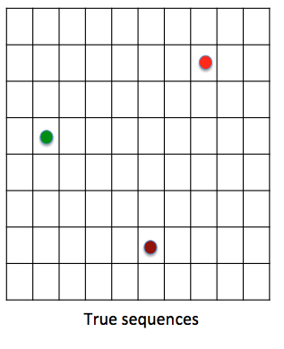
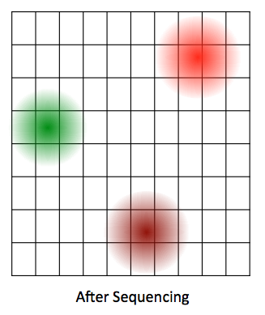
What normally happens during sequencing?
Notes:
Sequencing isn’t perfect - sometimes errors do occur, and what we see in our data does not exactly match the true sequences
For this reason, there are multiple possibilities for what the sequences actually are (based on what we see), so there is this kind of fuzzy area of the realm of possibilities for a sequence
Finds the cleanest sequence, corrects errors based on that sequence, and discards noisy sequences

Slide 31
Feature table
SampleID | Feature #1 | Feature #2 | Feature #3 | Feature #4 | Feature #5
person1-time1 | 0 | 3,476 | 103 | 1,903 | 2,871
person1-time2 | 1,289 | 2,234 | 105 | 33 | 109
person2-time1 | 239 | 1,586 | 145 | 56 | 2,250
person2-time2 | 1,913 | 1,704 | 136 | 1,078 | 876

Slide 32
Import data
Demultiplexed fasta file
Feature table
sequences.fastq(.gz)
SampleData[SequencesWithQuality]
FeatureTable[Frequency]
@HWI-6X_9267:1:1:25:1051
GACGAAGGTGACGACCGTTGCTCGGAATCACTGGGCATAAAGCGCGCGTAGGTGGCTTGGTAAGTCCATGGTGAAATCCCTCGGCTCAACCGAGGAACTG
+
abaaaaa`^`a_]^\``\``a`^`]]]^^`a[VXGX``Z_\\\_^\a^SYOZVVSVYGYVDXOZVT\TITBBBBBBBBBBBBBBBBBBBBBBBBBBBBBB
@HWI-6X_9267:1:1:25:267
TACGTATGGGGCAAGCGTTATCCGGAATTATTGGGCGTAAAGAGTGCGTAGGTGGTGGCTTAAGCGCAGGGTTTAAGGCAATGGCTTAACTATTGTTCTC
+
aa^^[__^^^_^_^[^^[^^____ZZ[^^[^]ZUZ]]WUZXYU[Q[X]UVXVN[XUWWURZUYY]XXRZRNVTRTNTWUUU^VJVOMIHQU\URRN[BBB
@HWI-6X_9267:1:1:25:609
TACGTAGGGGGCAAGCGTTATCCGGATTTACTGGGTGTAAAGGGAGCGTAGACGGATGGACAAGTCTGATGTGAAAGGCTGGGGCTCAACCCCGGGACGG
+
aaab`aaa`aaaaaaaaaaaaaaaa^aaaaaaaaYQ^`_^]a_]\a`a]``]Z_[][I^^aZZ^WW^_^`ZZ_T]XY^^\^ZX\ZJS[W[V^\HOVYTET
@HWI-6X_9267:1:1:25:519
GACGGAGGATGCAAGTGTTATCCGGAATCACTGGGCGTAAAGCGTCTGTAGGTGGTTTACTAAGTCAACTGTTAAATCTTGAGGCTCAACCTCGAAATCG
+
abaaaaaa`aaaaaa\aaaaaaa```aa_aaaa^Z__[ZY^aa`U[`^[]]YZ]WY]]_Z_XX\\[]]]^`[\XTVX]`T_VZ[]ZXVXYFX_VYJWWZL
@HWI-6X_9267:1:1:25:1109
TACGGAGGGTGCGAGCGTTAATCGGAATTACTGGGCGTAAAGCGTACGTAGGCGGTTAGGTAAGTCAGATGTGAAAGCCCCGGGCTCCACCTGGGAATGG
+
aaaba^`a^N_`\_``a_a]Zaa^^\Z`[M]a`[VYa^_X^_Z]NZ\`]TY\]_^RVH_PHOWZM[PTRPTRYUBBBBBBBBBBBBBBBBBBBBBBBBBB
4ac2.fastq(.gz)
 | feature1 | feature2 | feature3 | Feature 4 | feature5
4ac2 | 42 | 0 | 37 | 99 | 1
e375 | 12 | 1 | 22 | 88 | 0
4gd8 | 25 | 3 | 23 | 86 | 0
9872 | 0 | 0 | 87 | 12 | 0
@HWI-6X_9267:1:1:25:1051
GACGAAGGTGACGACCGTTGCTCGGAATCACTGGGCATAAAGCGCGCGTAGGTGGCTTGGTAAGTCCATGGTGAAATCCCTCGGCTCAACCGAGGAACTG
+
abaaaaa`^`a_]^\``\``a`^`]]]^^`a[VXGX``Z_\\\_^\a^SYOZVVSVYGYVDXOZVT\TITBBBBBBBBBBBBBBBBBBBBBBBBBBBBBB
@HWI-6X_9267:1:1:25:609
TACGTAGGGGGCAAGCGTTATCCGGATTTACTGGGTGTAAAGGGAGCGTAGACGGATGGACAAGTCTGATGTGAAAGGCTGGGGCTCAACCCCGGGACGG
+
aaab`aaa`aaaaaaaaaaaaaaaa^aaaaaaaaYQ^`_^]a_]\a`a]``]Z_[][I^^aZZ^WW^_^`ZZ_T]XY^^\^ZX\ZJS[W[V^\HOVYTET
barcodes.fastq(.gz)
e375.fastq(.gz)
@HWI-6X_9267:1:1:25:267
TACGTATGGGGCAAGCGTTATCCGGAATTATTGGGCGTAAAGAGTGCGTAGGTGGTGGCTTAAGCGCAGGGTTTAAGGCAATGGCTTAACTATTGTTCTC
+
aa^^[__^^^_^_^[^^[^^____ZZ[^^[^]ZUZ]]WUZXYU[Q[X]UVXVN[XUWWURZUYY]XXRZRNVTRTNTWUUU^VJVOMIHQU\URRN[BBB
@HWI-6X_9267:1:1:25:1051
AACGCAC
+
Bbbbbbb
@HWI-6X_9267:1:1:25:267
AAGAGAT
+
bbbbbbb
@HWI-6X_9267:1:1:25:609
AACGCAC
+
bbbbbbb
@HWI-6X_9267:1:1:25:519
ACAGCAG
+
bbbbbbb
@HWI-6X_9267:1:1:25:1109
ACAGCTA
+
bbbbbbb
4gd8.fastq(.gz)
@HWI-6X_9267:1:1:25:519
GACGGAGGATGCAAGTGTTATCCGGAATCACTGGGCGTAAAGCGTCTGTAGGTGGTTTACTAAGTCAACTGTTAAATCTTGAGGCTCAACCTCGAAATCG
+
abaaaaaa`aaaaaa\aaaaaaa```aa_aaaa^Z__[ZY^aa`U[`^[]]YZ]WY]]_Z_XX\\[]]]^`[\XTVX]`T_VZ[]ZXVXYFX_VYJWWZL
sample-metadata.tsv
9872.fastq(.gz)
@HWI-6X_9267:1:1:25:1109
TACGGAGGGTGCGAGCGTTAATCGGAATTACTGGGCGTAAAGCGTACGTAGGCGGTTAGGTAAGTCAGATGTGAAAGCCCCGGGCTCCACCTGGGAATGG
+
aaaba^`a^N_`\_``a_a]Zaa^^\Z`[M]a`[VYa^_X^_Z]NZ\`]TY\]_^RVH_PHOWZM[PTRPTRYUBBBBBBBBBBBBBBBBBBBBBBBBBB
SampleID | BarcodeSequence
4ac2 | AACGCAC
e375 | AAGAGAT
4gd8 | ACAGCAG
9872 | ACAGCTA
Representative sequences file
FeatureData[Sequence]
>feature5
GACGAAGGTGACGACCGTTGCTCGGAATCACTGGGCATAAAGCGCGCGTAGGTGGCTTGGTAAGTCCATGGTGAAATCCCTCGGCTCAACCGAGGAACTG
>feature4
TACGTAGGGGGCAAGCGTTATCCGGATTTACTGGGTGTAAAGGGAGCGTAGACGGATGGACAAGTCTGATGTGAAAGGCTGGGGCTCAACCCCGGGACGG
>feature2
TACGTATGGGGCAAGCGTTATCCGGAATTATTGGGCGTAAAGAGTGCGTAGGTGGTGGCTTAAGCGCAGGGTTTAAGGCAATGGCTTAACTATTGTTCTC
>feature1
GACGGAGGATGCAAGTGTTATCCGGAATCACTGGGCGTAAAGCGTCTGTAGGTGGTTTACTAAGTCAACTGTTAAATCTTGAGGCTCAACCTCGAAATCG
>feature3
TACGGAGGGTGCGAGCGTTAATCGGAATTACTGGGCGTAAAGCGTACGTAGGCGGTTAGGTAAGTCAGATGTGAAAGCCCCGGGCTCCACCTGGGAATGG

Slide 33
Taxonomic assignment of observed sequences
Assignment methods
Compare directly to a reference database
VSEARCH, BLAST
Predict using a machine learning classifier
RDP, QIIME2
Reference databases
Greengenes (16S rRNA)
SILVA (16S rRNA, 18S rRNA)
UNITE (ITS- fungal)

Slide 34
Once you predict your taxonomy, you can visualize relative abundance of taxa in each sample with a bar plot
100
75
50
25
0
Abundance
Notes:
Any taxa groups that look out of place?

Slide 35
Using taxonomy for quality control of your data

Slide 36
Animal host-associated microbiomes
Mitochondrial 16S sequences:
k__Bacteria;p__Proteobacteria;c__Alphaproteobacteria;o__Rickettsiales;f__mitochondria
Plant-associated microbiomes
Chloroplast 16S sequences:
k__Bacteria;p__Cyanobacteria;c__Chloroplast;o__Chlorophyta;f__;g__
k__Bacteria;p__Cyanobacteria;c__Chloroplast;o__Chlorophyta;f__Trebouxiophyceae;g__
k__Bacteria;p__Cyanobacteria;c__Chloroplast;o__Streptophyta;f__;g__

Slide 37
Comparing microbial communities
How many different OTUs/ASVs are there? Alpha diversity
How similar are pairs of samples? Beta diversity
Who is there? Taxonomic profiling, differential abundance testing

Slide 38
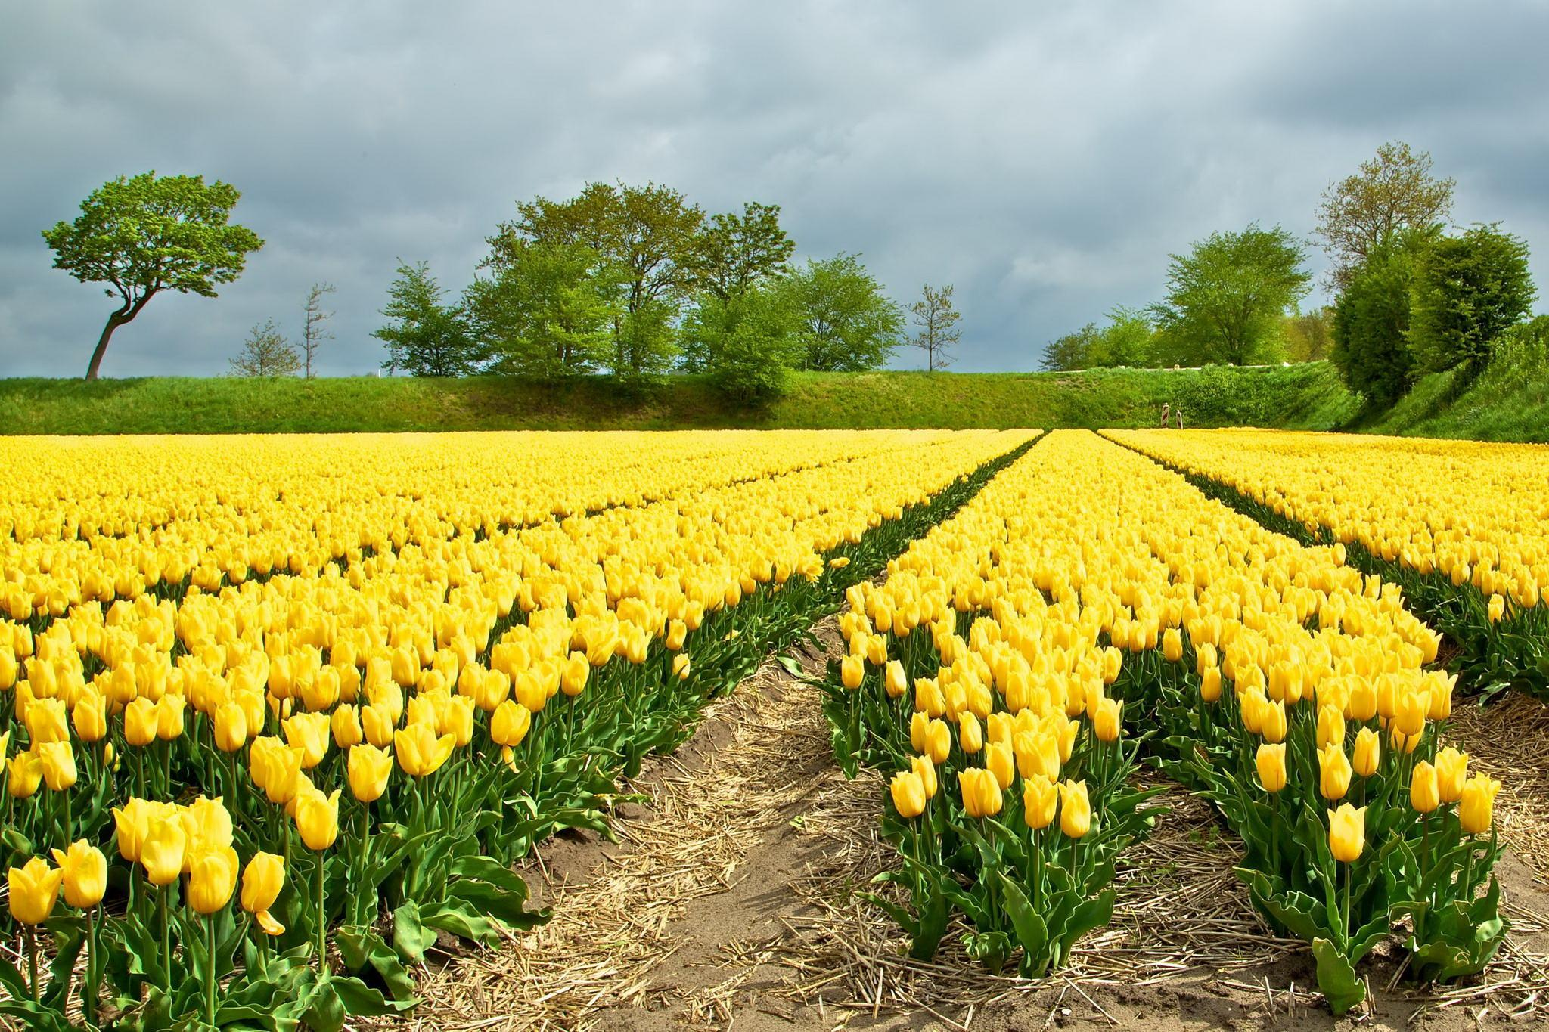
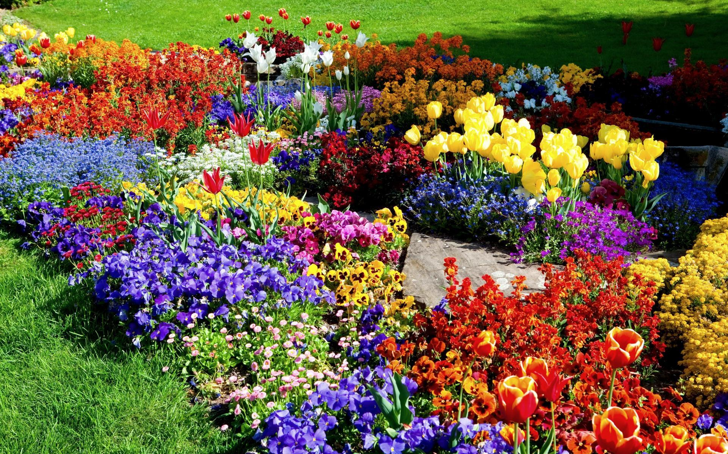
What features of microbiomes differ?
Community richness (often referred to as alpha diversity)
Image source: http://miriadna.com/desctopwalls/images/max/Field-of-yellow-tulips.jpg
Image source:
https://imgflip.com/memetemplate/62338435/Flower-garden
Notes:
So here is an example of Alpha Diversity of the Richness
●To the left we have a garden that only has tulips in it. While on the right we have a garden that has yellow tulips in addition to many other flowers.
●So by comparing the different types of flowers between these 2 gardens we are looking at the Alpha diversity of the Richness between them
NEXT SLIDE

Slide 39
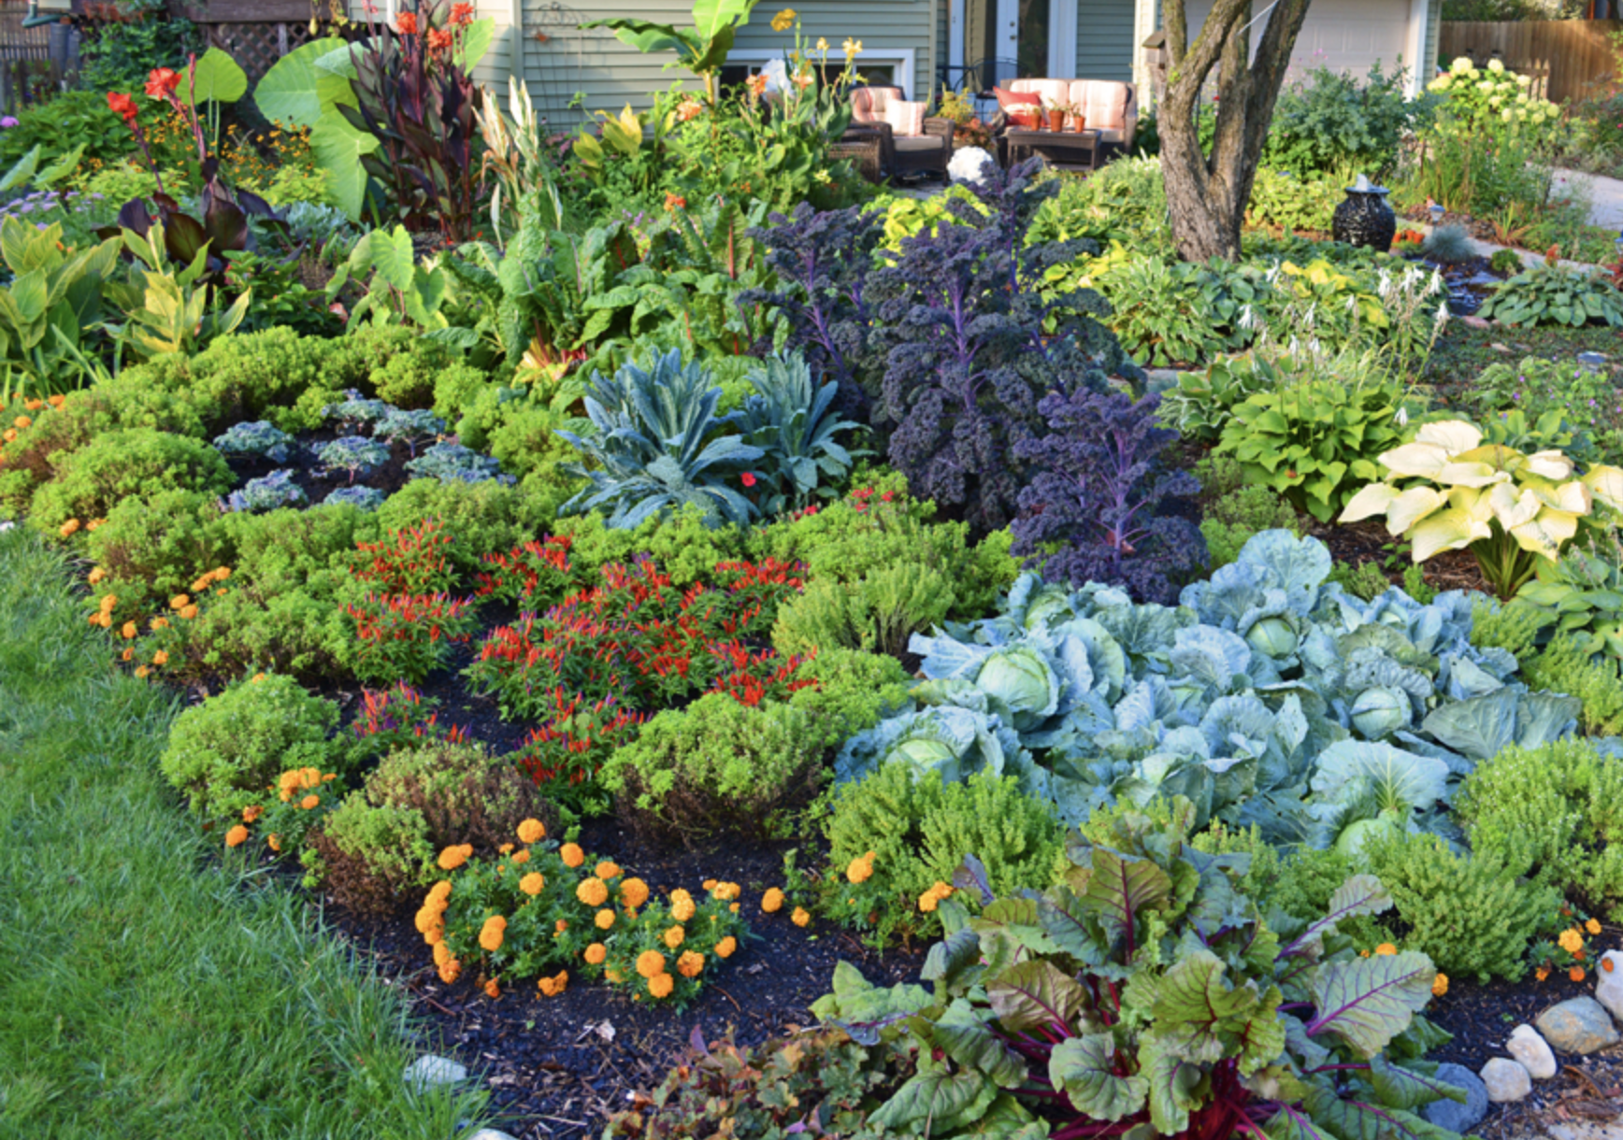
What features of microbiomes differ?
Community composition (often referred to as beta diversity)
Image source:
https://shawnacoronado.com/front-lawn-vegetable-garden-design/
Image source:
https://imgflip.com/memetemplate/62338435/Flower-garden
Notes:
So we here we are looking at community composition.
•Essentially we are seeing two gardens that have similar Richness but each garden has different types of plants.
•Beta diversity will help us understand this comparison
NEXT SLIDE

Slide 40
Non-phylogenetic diversity metrics assume that all taxa are equally related, so doesn’t make assumptions about evolutionary relationships.
Phylogenetic diversity metrics incorporate evolutionary relationships between taxa, but assume that we know what those relationships are.
Notes:
Non-phylogenetic metrics – pileou’s evenness, Shannon’s diversity, simpson’s diversity, inverse simpson’s diversity, etc.
Phylogenetic- faith’s pd
Why would phylogenetic relationships be important?

Slide 41
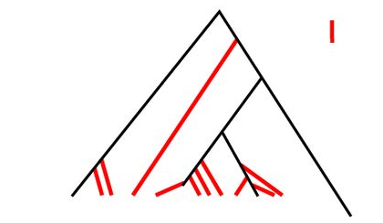
Import data
Demultiplexed fasta file
Feature table
sequences.fastq(.gz)
SampleData[SequencesWithQuality]
FeatureTable[Frequency]
@HWI-6X_9267:1:1:25:1051
GACGAAGGTGACGACCGTTGCTCGGAATCACTGGGCATAAAGCGCGCGTAGGTGGCTTGGTAAGTCCATGGTGAAATCCCTCGGCTCAACCGAGGAACTG
+
abaaaaa`^`a_]^\``\``a`^`]]]^^`a[VXGX``Z_\\\_^\a^SYOZVVSVYGYVDXOZVT\TITBBBBBBBBBBBBBBBBBBBBBBBBBBBBBB
@HWI-6X_9267:1:1:25:267
TACGTATGGGGCAAGCGTTATCCGGAATTATTGGGCGTAAAGAGTGCGTAGGTGGTGGCTTAAGCGCAGGGTTTAAGGCAATGGCTTAACTATTGTTCTC
+
aa^^[__^^^_^_^[^^[^^____ZZ[^^[^]ZUZ]]WUZXYU[Q[X]UVXVN[XUWWURZUYY]XXRZRNVTRTNTWUUU^VJVOMIHQU\URRN[BBB
@HWI-6X_9267:1:1:25:609
TACGTAGGGGGCAAGCGTTATCCGGATTTACTGGGTGTAAAGGGAGCGTAGACGGATGGACAAGTCTGATGTGAAAGGCTGGGGCTCAACCCCGGGACGG
+
aaab`aaa`aaaaaaaaaaaaaaaa^aaaaaaaaYQ^`_^]a_]\a`a]``]Z_[][I^^aZZ^WW^_^`ZZ_T]XY^^\^ZX\ZJS[W[V^\HOVYTET
@HWI-6X_9267:1:1:25:519
GACGGAGGATGCAAGTGTTATCCGGAATCACTGGGCGTAAAGCGTCTGTAGGTGGTTTACTAAGTCAACTGTTAAATCTTGAGGCTCAACCTCGAAATCG
+
abaaaaaa`aaaaaa\aaaaaaa```aa_aaaa^Z__[ZY^aa`U[`^[]]YZ]WY]]_Z_XX\\[]]]^`[\XTVX]`T_VZ[]ZXVXYFX_VYJWWZL
@HWI-6X_9267:1:1:25:1109
TACGGAGGGTGCGAGCGTTAATCGGAATTACTGGGCGTAAAGCGTACGTAGGCGGTTAGGTAAGTCAGATGTGAAAGCCCCGGGCTCCACCTGGGAATGG
+
aaaba^`a^N_`\_``a_a]Zaa^^\Z`[M]a`[VYa^_X^_Z]NZ\`]TY\]_^RVH_PHOWZM[PTRPTRYUBBBBBBBBBBBBBBBBBBBBBBBBBB
4ac2.fastq(.gz)
 | feature1 | feature2 | feature3 | Feature 4 | feature5
4ac2 | 42 | 0 | 37 | 99 | 1
e375 | 12 | 1 | 22 | 88 | 0
4gd8 | 25 | 3 | 23 | 86 | 0
9872 | 0 | 0 | 87 | 12 | 0
@HWI-6X_9267:1:1:25:1051
GACGAAGGTGACGACCGTTGCTCGGAATCACTGGGCATAAAGCGCGCGTAGGTGGCTTGGTAAGTCCATGGTGAAATCCCTCGGCTCAACCGAGGAACTG
+
abaaaaa`^`a_]^\``\``a`^`]]]^^`a[VXGX``Z_\\\_^\a^SYOZVVSVYGYVDXOZVT\TITBBBBBBBBBBBBBBBBBBBBBBBBBBBBBB
@HWI-6X_9267:1:1:25:609
TACGTAGGGGGCAAGCGTTATCCGGATTTACTGGGTGTAAAGGGAGCGTAGACGGATGGACAAGTCTGATGTGAAAGGCTGGGGCTCAACCCCGGGACGG
+
aaab`aaa`aaaaaaaaaaaaaaaa^aaaaaaaaYQ^`_^]a_]\a`a]``]Z_[][I^^aZZ^WW^_^`ZZ_T]XY^^\^ZX\ZJS[W[V^\HOVYTET
barcodes.fastq(.gz)
e375.fastq(.gz)
@HWI-6X_9267:1:1:25:267
TACGTATGGGGCAAGCGTTATCCGGAATTATTGGGCGTAAAGAGTGCGTAGGTGGTGGCTTAAGCGCAGGGTTTAAGGCAATGGCTTAACTATTGTTCTC
+
aa^^[__^^^_^_^[^^[^^____ZZ[^^[^]ZUZ]]WUZXYU[Q[X]UVXVN[XUWWURZUYY]XXRZRNVTRTNTWUUU^VJVOMIHQU\URRN[BBB
@HWI-6X_9267:1:1:25:1051
AACGCAC
+
Bbbbbbb
@HWI-6X_9267:1:1:25:267
AAGAGAT
+
bbbbbbb
@HWI-6X_9267:1:1:25:609
AACGCAC
+
bbbbbbb
@HWI-6X_9267:1:1:25:519
ACAGCAG
+
bbbbbbb
@HWI-6X_9267:1:1:25:1109
ACAGCTA
+
bbbbbbb
4gd8.fastq(.gz)
@HWI-6X_9267:1:1:25:519
GACGGAGGATGCAAGTGTTATCCGGAATCACTGGGCGTAAAGCGTCTGTAGGTGGTTTACTAAGTCAACTGTTAAATCTTGAGGCTCAACCTCGAAATCG
+
abaaaaaa`aaaaaa\aaaaaaa```aa_aaaa^Z__[ZY^aa`U[`^[]]YZ]WY]]_Z_XX\\[]]]^`[\XTVX]`T_VZ[]ZXVXYFX_VYJWWZL
sample-metadata.tsv
9872.fastq(.gz)
@HWI-6X_9267:1:1:25:1109
TACGGAGGGTGCGAGCGTTAATCGGAATTACTGGGCGTAAAGCGTACGTAGGCGGTTAGGTAAGTCAGATGTGAAAGCCCCGGGCTCCACCTGGGAATGG
+
aaaba^`a^N_`\_``a_a]Zaa^^\Z`[M]a`[VYa^_X^_Z]NZ\`]TY\]_^RVH_PHOWZM[PTRPTRYUBBBBBBBBBBBBBBBBBBBBBBBBBB
SampleID | BarcodeSequence
4ac2 | AACGCAC
e375 | AAGAGAT
4gd8 | ACAGCAG
9872 | ACAGCTA
Representative sequences file
rooted-tree.qza
FeatureData[Sequence]
Phylogeny[Rooted]
>feature5
GACGAAGGTGACGACCGTTGCTCGGAATCACTGGGCATAAAGCGCGCGTAGGTGGCTTGGTAAGTCCATGGTGAAATCCCTCGGCTCAACCGAGGAACTG
>feature4
TACGTAGGGGGCAAGCGTTATCCGGATTTACTGGGTGTAAAGGGAGCGTAGACGGATGGACAAGTCTGATGTGAAAGGCTGGGGCTCAACCCCGGGACGG
>feature2
TACGTATGGGGCAAGCGTTATCCGGAATTATTGGGCGTAAAGAGTGCGTAGGTGGTGGCTTAAGCGCAGGGTTTAAGGCAATGGCTTAACTATTGTTCTC
>feature1
GACGGAGGATGCAAGTGTTATCCGGAATCACTGGGCGTAAAGCGTCTGTAGGTGGTTTACTAAGTCAACTGTTAAATCTTGAGGCTCAACCTCGAAATCG
>feature3
TACGGAGGGTGCGAGCGTTAATCGGAATTACTGGGCGTAAAGCGTACGTAGGCGGTTAGGTAAGTCAGATGTGAAAGCCCCGGGCTCCACCTGGGAATGG

Slide 42
There are a lot of alpha diversity metrics
Observed ASVs – richness (# of ASVs)
Shannon Diversity Index – richness and evenness
Faith’s Phylogenetic diversity – sum of branch lengths

Slide 43
Observed OTUs (or Observed Species):
non-phylogenetic, alpha diversity metric measuring richness
FeatureTable[Frequency]
SampleData[AlphaDiversity]
 | feature1 | feature2 | feature3 | feature4 | feature5
4ac2 | 25 | 30 | 15 | 0 | 0
e375 | 0 | 17 | 33 | 25 | 0
 | Observed OTUs
4ac2
e375
Notes:
Richness
Still called observed OTUs even when its ASV/ESV

Slide 44
Observed OTUs (or Observed Species):
non-phylogenetic, alpha diversity metric measuring richness
FeatureTable[Frequency]
SampleData[AlphaDiversity]
 | feature1 | feature2 | feature3 | feature4 | feature5
4ac2 | 25 | 30 | 15 | 0 | 0
e375 | 0 | 17 | 33 | 25 | 0
 | Observed OTUs
4ac2 | 3
e375 | 3
Notes:
Walk through math

